Slide 1
Real-time Data Processing and Prediction using API and Streamlit

Slide 2
Agenda
Project Overview
Backend Development
Frontend Development
Insights

Slide 3
Project Overview

Slide 4
Introduction
Demonstrate real world application skills.
Create an end-to-end machine learning project.
Utilize industry standard tools such as Kafka, Streamlit, Pandas, Scikit-Learn, etc.
Takes stock price data from a real time source and predicts the future stock price.
Model updates periodically as new information is fed to it.
Price is displayed along with underlying metrics in a dashboard for easy consumption.
Notes:
This slide highlights the project as a whole and how it was put together.

Slide 5
Project Environment
Ran a Kafka environment locally using a Docker container.
Container ID: 55c754298ccbcdd298113fc7f168658ce92278cd6035687b9e2b0e9ac3d871d7
Runs locally on port 9092.
Created a virtual environment (Week7) in the repo.
Python version 3.10+
See requirements.txt for full venv details.
Created a Streamlit application that runs locally on port 8501.
Scripts were created in a WSL2 Debian distribution on Windows 11.
GitHub Repo: https://github.com/jeffmoe/CST_605_Week7.git
Notes:
This slide details the environment the project was created in.

Slide 6
Data Flow Diagram
Finnhub.io Api
Kafka Producer (producer.py)
Kafka Consumer (consumer_processor.py)
SGDRegressor Model (model_utils.py)
Price Predictor and Metric Dashboard (streamlit_app.py)
Notes:
This slide shows the flow of data in the application.

Slide 7

Backend Development

Slide 8
Setup_Kafka.py
Creates the initial topics and sets their partitions and replication factor.
Does this by the function create_topics(bootstrap_servers: str, topics=DEFAULT_TOPICS) -> None:
Contains logging to ensure proper operation.
Notes:
This slide goes over the setup_kafka script to create the topics initially.

Slide 9
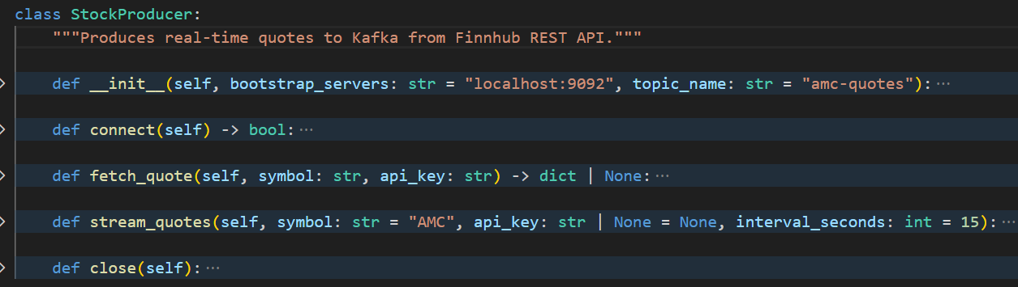
Finnhub.io API Integration
Used Api token to get data from Finnhub for AMC stock price every 15 seconds.
Data is gathered by Kafka Producer (producer.py)
FINNHUB_BASE = "https://finnhub.io/api/v1/quote"
Created a custom data class: StockProducer
Implemented logging at key stages to ensure operations.
Exported the API key locally so it is not hard coded in the script for security.
Please refer to the Github repo for the source code.
__init__: initializes the class to be used and passes variables to be used by all functions.
Connect: connects the producer to the Kafka instance.
Fetch_quote: gets the latest value from Finnhub.io based on the stock symbol.
Stream_quote: uses fetch_quote and grabs values continuously at certain intervals.
Close: flushes the values and properly closes the producer.
Notes:
This slide goes over the api integration from Finnhub and how it is used by the kafka producer.

Slide 10
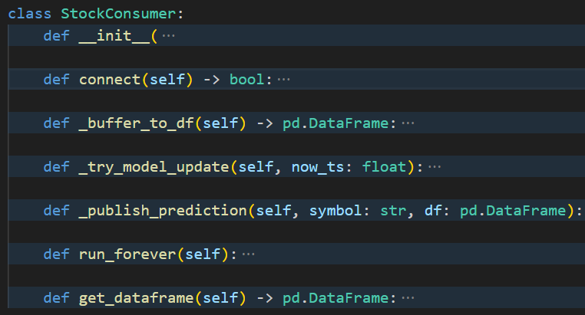
Consuming the Data
Created a consumer script to get the data from the producer and store it in a dataframe for model use.
Contains logging functionality like the other scripts.
Created custom class StockConsumer.
Please refer to the GitHub repo for the source code.
__init__: initializes the class and passes values to be used by other functions.
connect: connects the script to the consumer and producer.
_buffer_to_df: initializes the df if it does not exist and writes values to it from the producer.
_try_model_update: sends the data from the df to update the prediction model.
_publish_prediction: sends the prediction from the model to the producer under the predictions topic.
Run_forever: takes in the functions above to continuously run the consumer and output predictions until there is a keystroke interruption.
Get_dataframe: returns a df from the _buffer_to_df function cleaner.
Notes:
This slide goes over the kafka consumer and how it also produces prediction data to be grabbed by our model and dashboard.

Slide 11
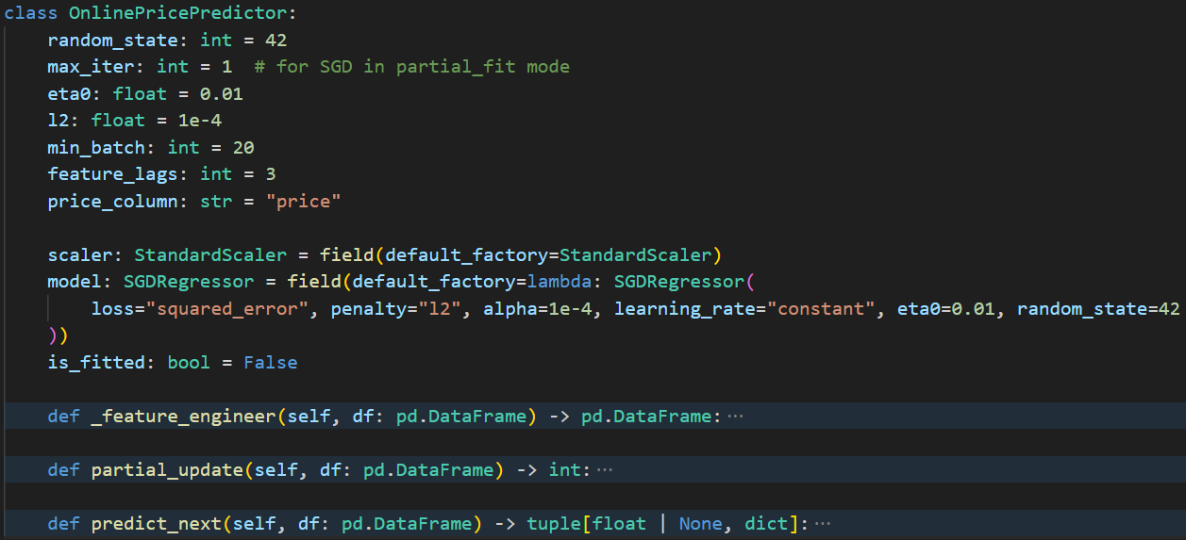
Model Creation
Uses a SGDRegressor to continually predict the next stock price based on the previous values.
Contains error handling for partial or missing values.
Performs feature engineering and creates a pipeline for the model.
Replicates the scaling and ensures the data is passed in the same way each time.
Processes new data in batches of 20 values.
Created a custom class OnlinePricePredictor.
Please refer to the GitHub repo for source code.
_feature_engineer: creates rolling averages, removes missing values, looks at time of day.
Partial_update: updates the model with the new values as they come in. performs the feature engineering first.
Predict_next: predicts the next stock price based on the updates from the previous function.
Notes:
This slide goes over the model creation itself, using a regressor to provide price predictions to compare against actual stock prices.

Slide 12

Frontend Development

Slide 13
Streamlit Dashboard
Takes the predictions from the model and displays them.
Displays the current actual price as well.
Has a slider for adjusting the price in a what if scenario.
Displays model metrics like MAE and RSME.
Displays risiduals (histograms) for error in prediction.
Displays graphs for predicted price vs actual price.
Has tables of raw values of actual price from the API and the predicted values.
Has a sidebar to pass testing values through.
Notes:
This slide is an overview of what is on the streamlit dashboard.

Slide 14
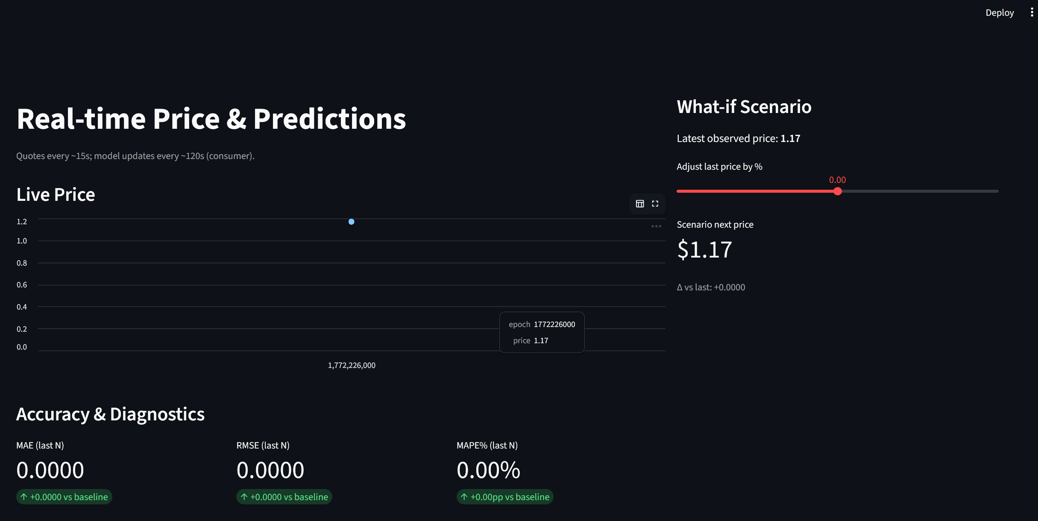
Streamlit_app.py Live Pricing and Predictions

Slide 15
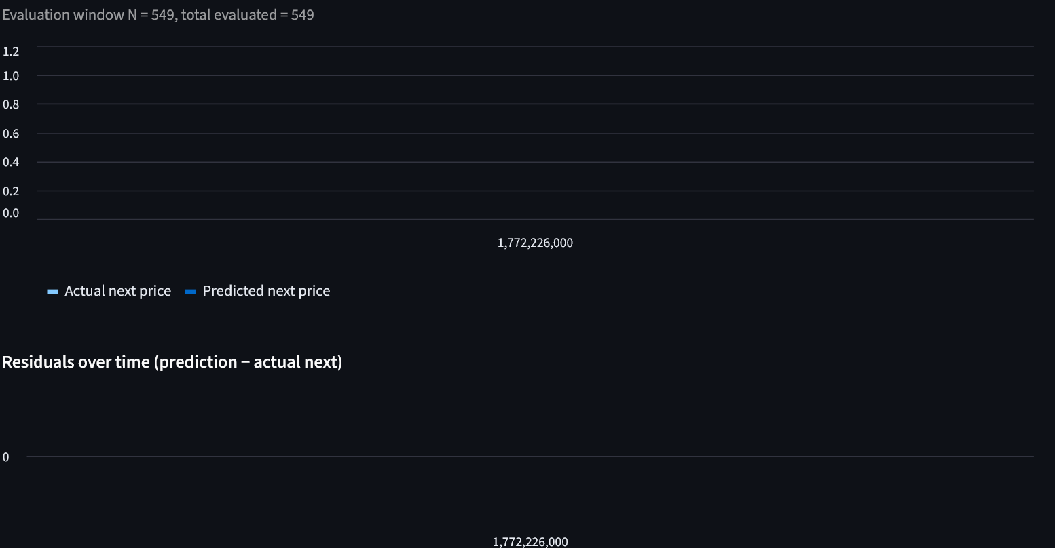
Streamlit_app.py Comparing Predictions

Slide 16
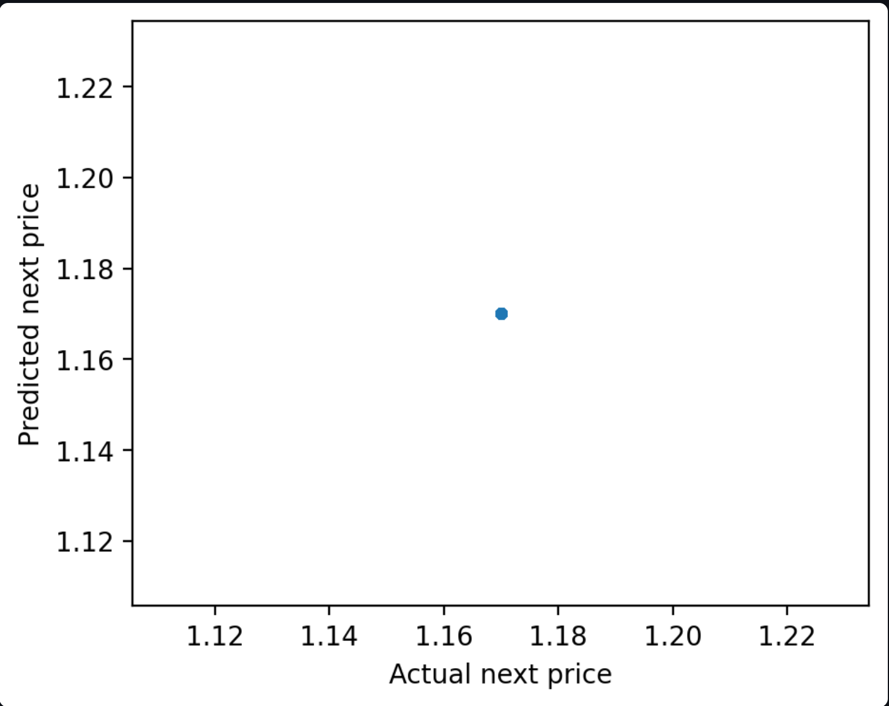
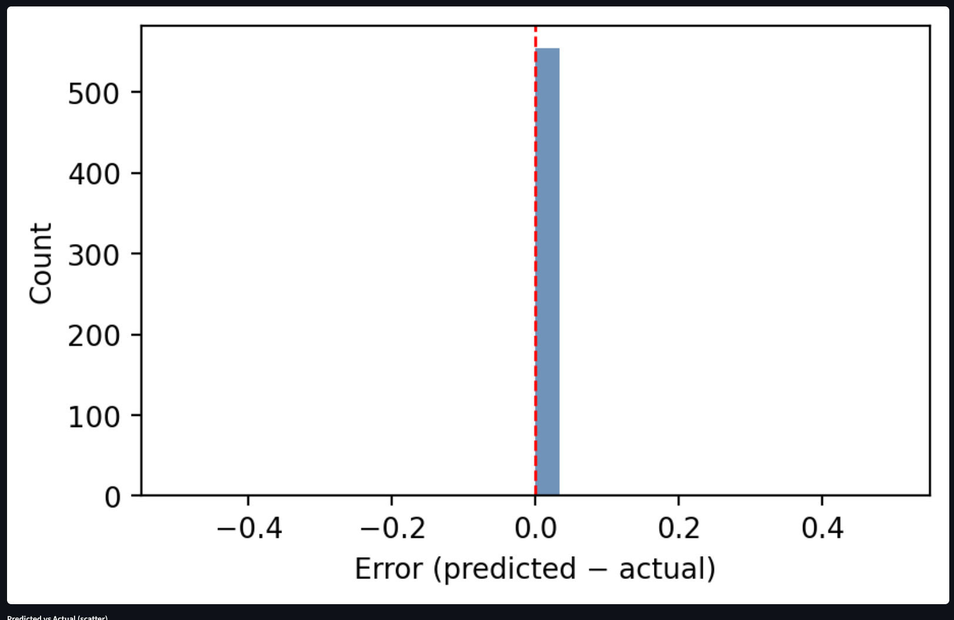
Streamlit_app.py Graphs

Slide 17
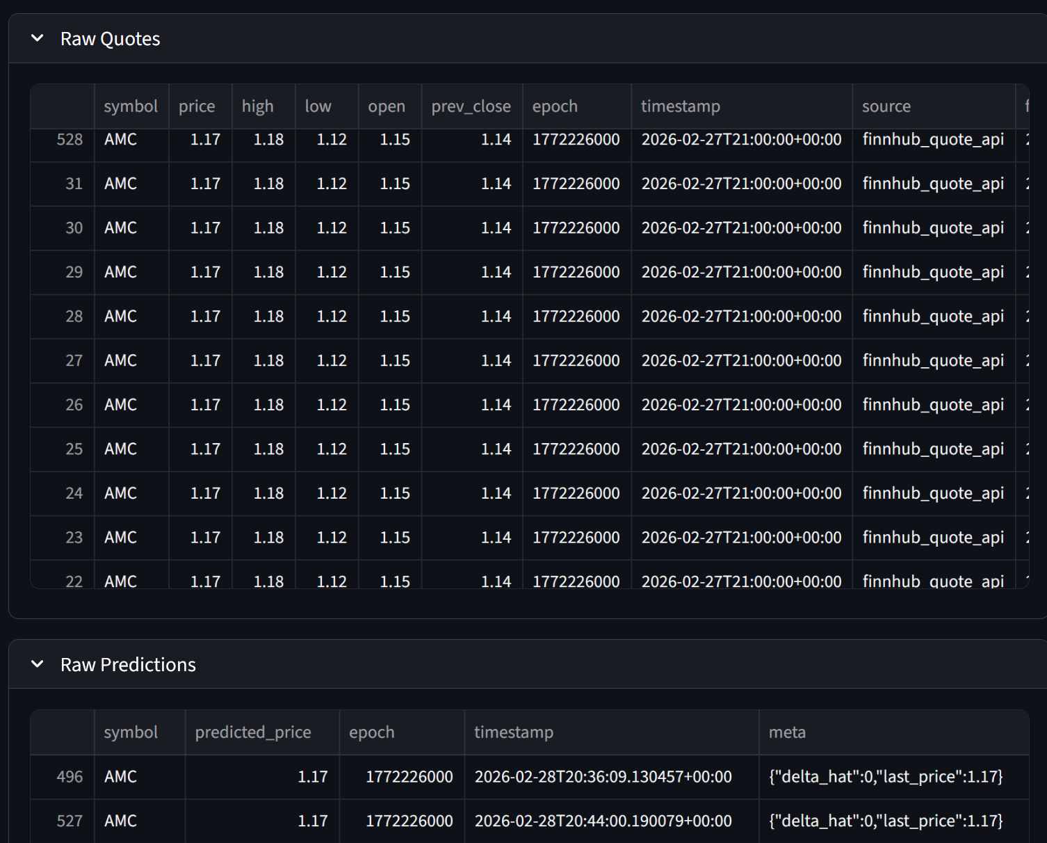
Streamlit_app.py Data Tables

Slide 18
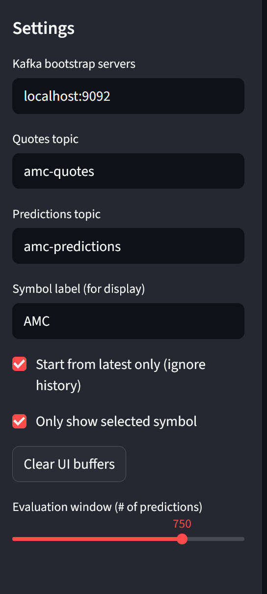
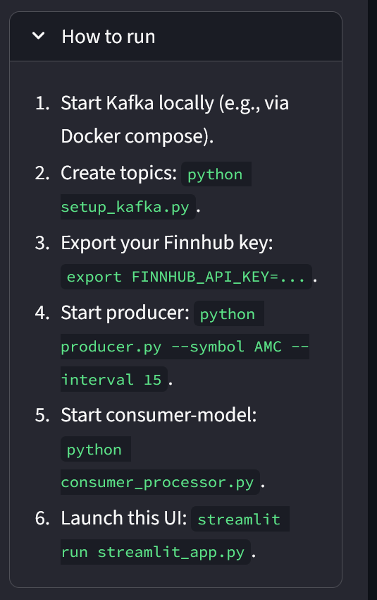
Streamlit_app.py Sidebar

Slide 19

Insights

Slide 20
Putting it All Together
Initialize Kafka instance in Docker.
Open a terminal – $ python setup_kafka.py
In that terminal - $ export FINNHUB_API_KEY=<paste key>
Same terminal - $python producer.py
New terminal, leave the other one running - $python consumer_processor.py
New terminal, leave the other two running - $streamlit run streamlit_app.py
Go to http://localhost:8501/ to view the dashboard!
Notes:
This slide details the steps to running the application.

Slide 21
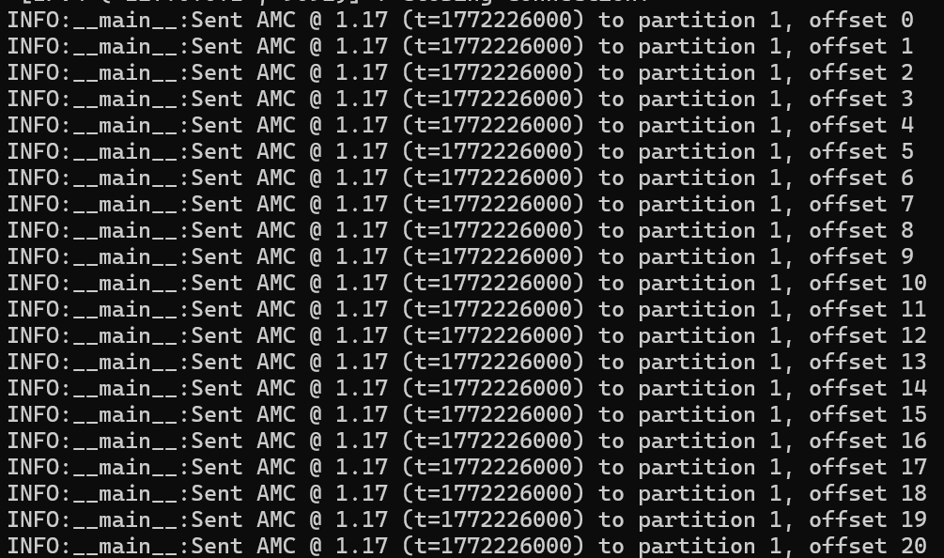
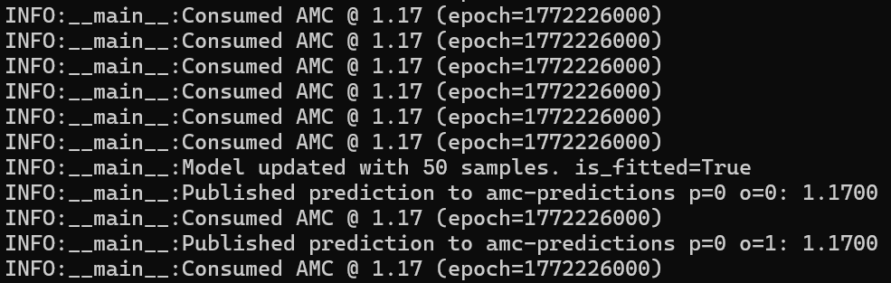
Expected Outputs from Terminals
Producer Output
Consumer Output

Slide 22
Conclusion and Recommendations
Run the application when the stock price is actually changing.
Run on a Saturday after market close.
Have the model be able to distinguish between multiple stock symbols.
Be able to drop in additional models for each symbol.
Continue to update and improve security profile.
Instead of localhost, fire up a EC2 on AWS to host it over the internet for all.
Notes:
This slide goes over the potential improvements to the application.

Slide 23
Bibliography
Verina Khella. (2025, February 13). Streamlit For Beginners: Build Your First Dashboard. Medium. https://medium.com/@verinamk/streamlit-for-beginners-build-your-first-dashboard-58b764a62a2d
INTRODUCING MLOPS : how to scale machine learning in the enterprise. (2021). O’reilly Media, Inc, Usa.
Finnhub.io. (n.d.). Finnhub - Free realtime APIs for stock, forex and cryptocurrency. Finnhub.io. https://finnhub.io/docs/api/introduction
Datamapu. (2022, July 12). Evidently AI — Easy analyze your Data and Machine Learning Model. Medium; MLearning.ai. https://medium.com/@pumaline/easy-analysis-of-your-data-and-ml-model-using-evidently-ai-830ef0c1c4fd
Streamlit. (2023, December 14). Crafting a Dashboard App in Python using Streamlit. YouTube. https://www.youtube.com/watch?v=asFqpMDSPdM
Richards, T. (2023). Streamlit for Data Science. Packt Publishing Ltd.

Slide 24
Bibliography
Pykes, K. (2024, March 13). Apache Kafka for Beginners: A Comprehensive Guide. Datacamp.com; DataCamp. https://www.datacamp.com/tutorial/apache-kafka-for-beginners-a-comprehensive-guide
GeeksforGeeks. (2023, December 26). Python API Tutorial: Getting Started with APIs. GeeksforGeeks. https://www.geeksforgeeks.org/python/python-api-tutorial-getting-started-with-apis/
Advanced Python Scheduler — APScheduler 3.9.1 documentation. (n.d.). Apscheduler.readthedocs.io. https://apscheduler.readthedocs.io/en/3.x/
Weatherstack - Real-Time World Weather REST API. (2026). Weatherstack. https://weatherstack.com/quickstart
Devopedia. (2022, May 28). Apache Kafka — An Introduction to Real Time Data Streaming. YouTube. https://www.youtube.com/watch?v=FhdNV6704bU

Slide 25
Bibliography
How to Use Apache Kafka for Real-Time Data Streaming? (n.d.). ProjectPro. https://www.projectpro.io/article/kafka-for-real-time-streaming/916
Gaur, C. (2024, August 16). Apache Fink 2.0 - Real-Time Data Processing. Xenonstack.com; Xenonstack Inc. https://www.xenonstack.com/insights/apache-flink-real-time-data
XQ. (2022, September 17). Creating a Real-time Data Stream Using Apache Kafka in Python. Medium; The Research Nest. https://medium.com/the-research-nest/creating-a-real-time-data-stream-using-apache-kafka-in-python-132e0e5630d3
Hariharan, S. (2022, September 22). Build a Simple Realtime Data Pipeline. Analytics Vidhya. https://www.analyticsvidhya.com/blog/2022/09/build-a-simple-realtime-data-pipeline/
What is Streaming Data? - Streaming Data Explained - AWS. (n.d.). Amazon Web Services, Inc. https://aws.amazon.com/what-is/streaming-data/

Slide 26
Bibliography
Data Ingestion: An Introduction to Data Collection and Processing. (n.d.). Confluent. https://www.confluent.io/learn/data-ingestion/
Welcome To Zscaler Directory Authentication. (2026). Geeksforgeeks.org. https://www.geeksforgeeks.org/python/sched-module-in-python/
What is Pub/Sub Messaging? - Pub/Sub Messaging Explained - AWS. (n.d.). Amazon Web Services, Inc. https://aws.amazon.com/what-is/pub-sub-messaging/
Newman, S. (2018). BUILDING MICROSERVICES : designing fine-grained systems. O’Reilly Media.

Slide 27
Bibliography
GeeksforGeeks. (2023, October 30). Stochastic Gradient Descent Regressor. GeeksforGeeks. https://www.geeksforgeeks.org/python/stochastic-gradient-descent-regressor/
sklearn.linear_model.SGDRegressor — scikit-learn 0.24.2 documentation. (n.d.). Scikit-Learn.org. https://scikit-learn.org/stable/modules/generated/sklearn.linear_model.SGDRegressor.html
AlgoStalk. (2024, October 29). Use SGD Regressor When Data is Constantly Updating: A Comprehensive Guide to Stochastic Gradient…. Medium. https://medium.com/@algostalk/use-sgd-regressor-when-data-is-constantly-updating-a-comprehensive-guide-to-stochastic-gradient-61f48fe3337c

